Slide 1

Custom Bootcamp
Week 6 (Sep 25 - Sep 29)
Pagidala Saketh Reddy
Employee code: 655074
Unext ID: SH7B23136

Slide 2

Agenda
Sep 25th – PySpark Session 3
Sep 26th – Azure Databricks Session 1
Sep 27th – Azure Databricks Session 2
Sep 28th – Azure Containers
Sep 29th – Azure Deployment / Devops

Slide 3
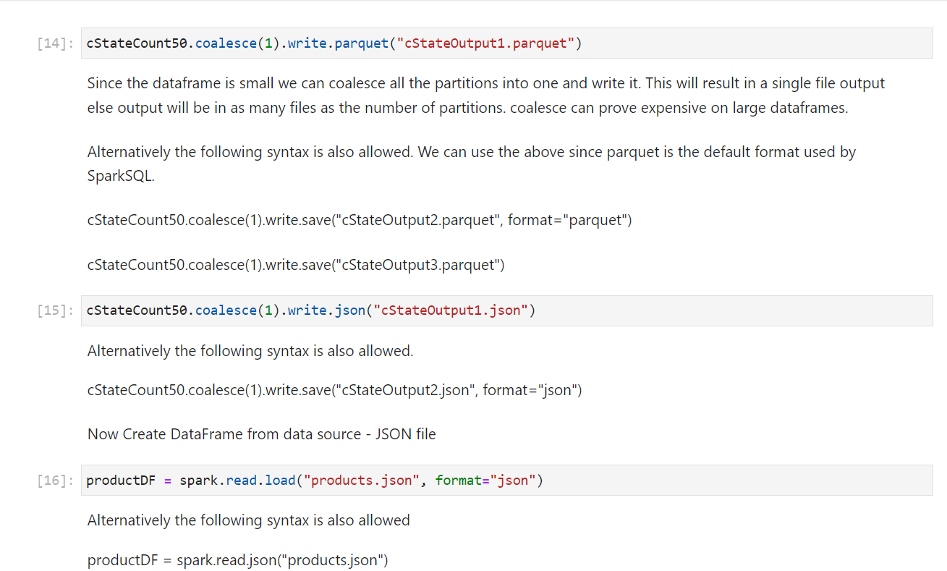
PySpark Session 3
Topics
Data Cleaning and sub setting
Handling Null Values in data frame
Transforming the data through various approaches
Filtering Data and Dropping
Reading Data from files and dataset

Slide 4
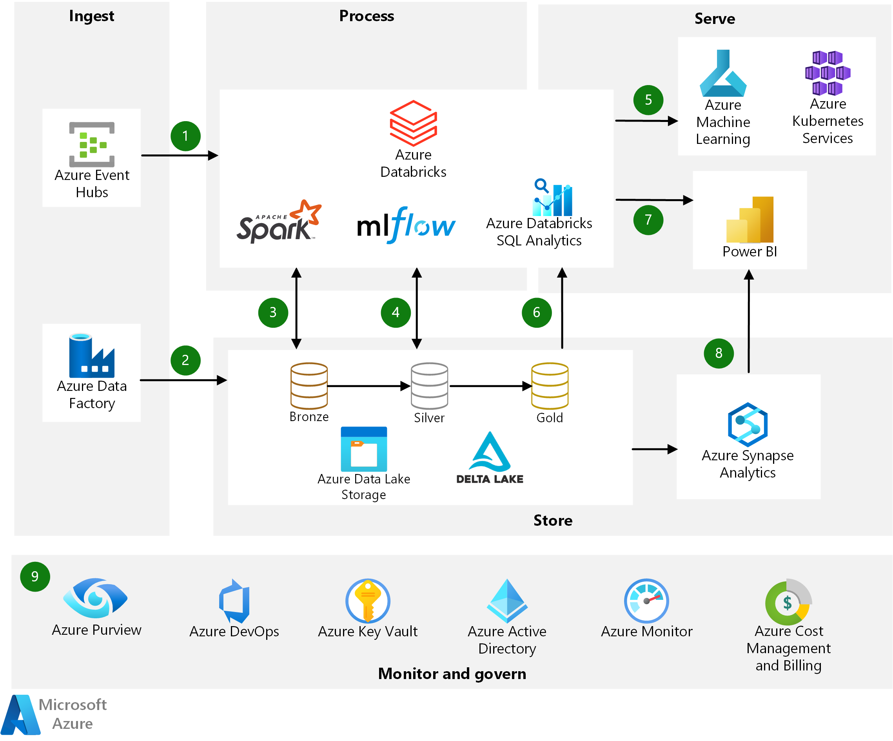
Data Bricks Session 1
Topics
Databricks Introduction and overview
Data Bricks High Level architecture
Azure Databricks using pyspark
Connect data bricks to data lake and mounting using SPN, access key and SAS

Slide 5
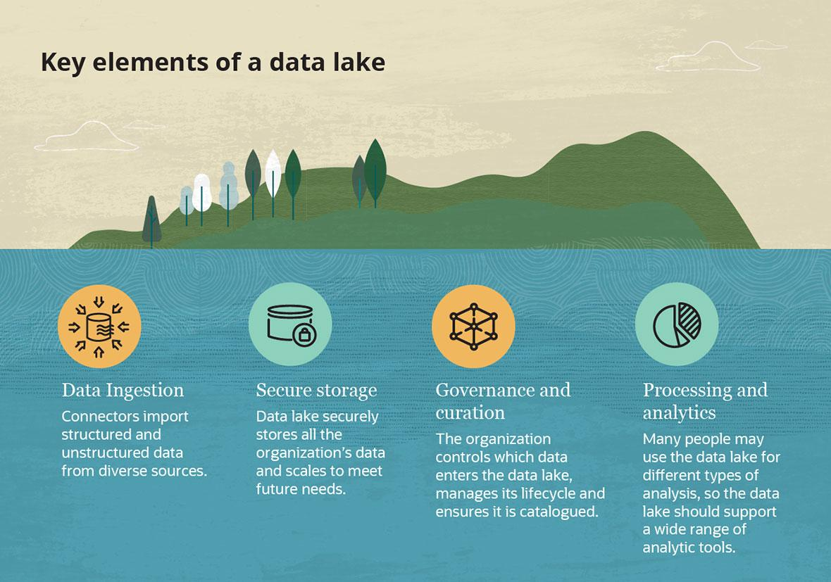
Data Bricks Session 2
Topics
Security and Data Protection in data bricks.
Delta lake concept, Error Handling and Scheduling
Connecting Databricks to Github for Code changes
Setting up azure SQL endpoint using Data bricks

Slide 6
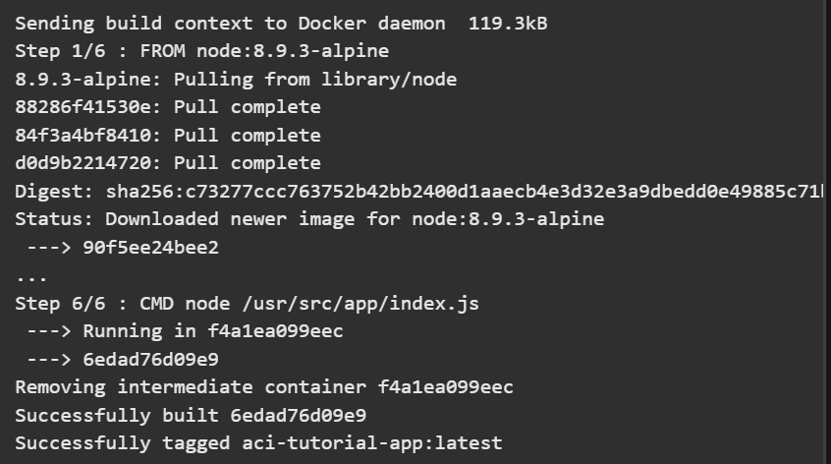
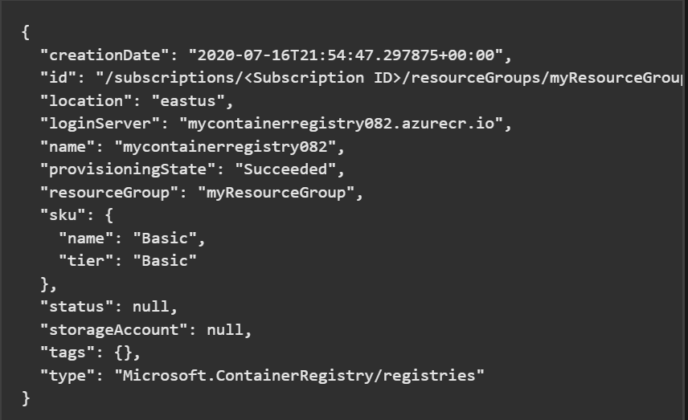
Azure Containers
Topics
Introduction to Docker
Creating a simple containerized web application and running it
Deploying the azure container images
Introduction to Kubernetes and Kubernetes service

Slide 7
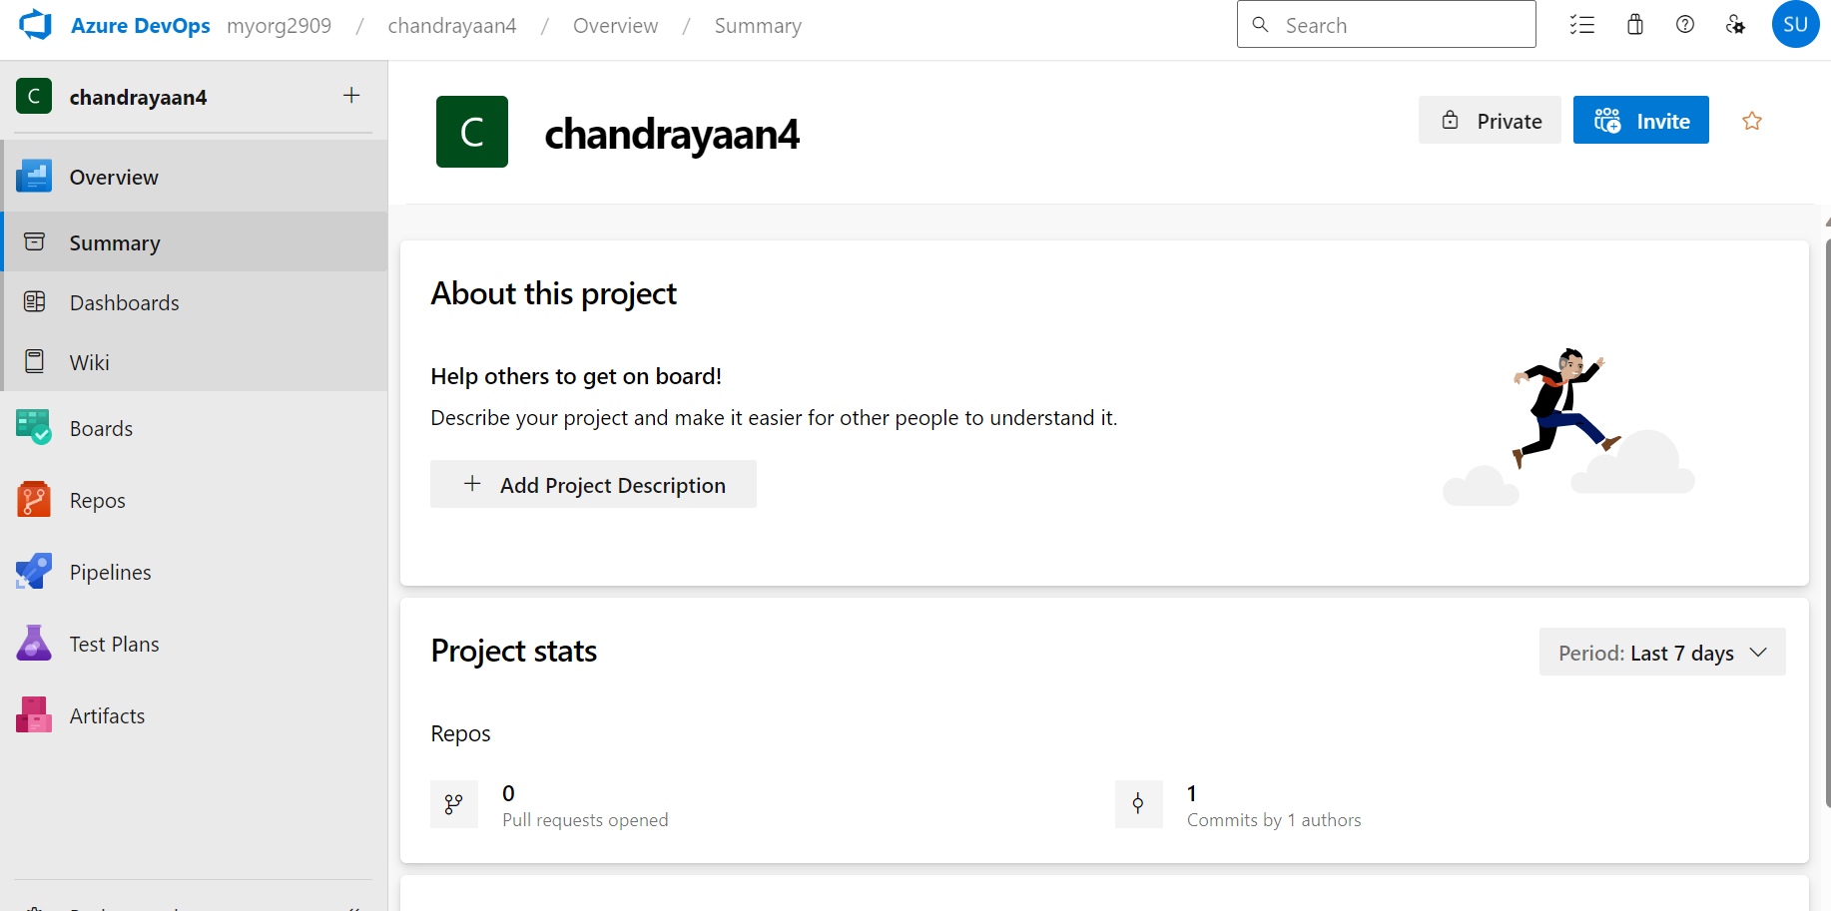
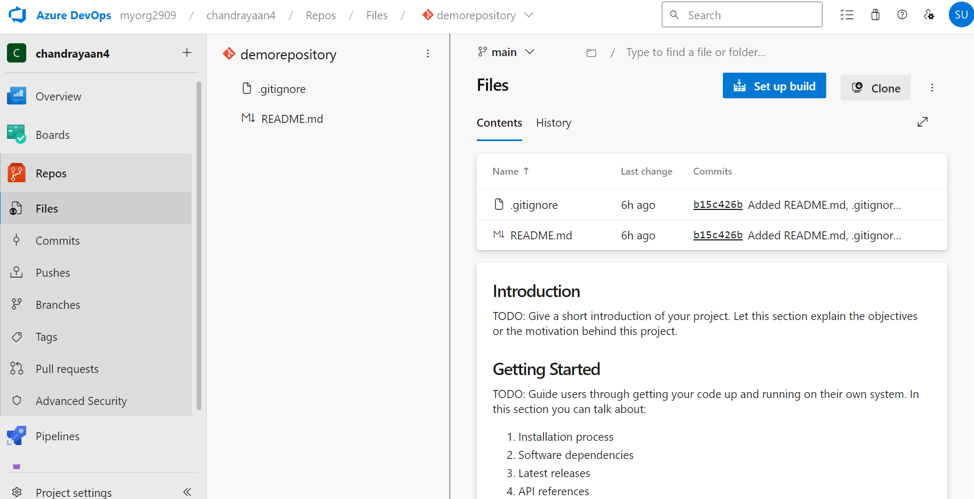
Azure Deployment/ Devops
Topics
Overview of azure Services for Devops and Deployment
Waterfall and Agile methodologies and their pros and cons
Introduction to continuous integration and continuous deployment
GitHub Repos and GitHub actions integration

Slide 8

Thank You

